Slide 1
Web scrapping
Rhul patel
asit kumar Biswal
gyano Ranjan palei

Slide 2
introduction
Web scraping is the process of extracting data from websites, and it has become an essential tool for businesses and organizations across industries.
Web scraping so important able to gather valuable insights from thousands of websites in just a matter of minutes. With web scraping, you can do just that.
In today's digital landscape, information a power, and web scraping gives you the power to collect and analyze vast amount of data quickly and efficiently by automating the process of data extraction, web scraping enables us to make informed decisions based on real-time information.

Slide 3
What is Web Scraping?
Web scraping is the process of automatically extracting data from websites. This can include anything from product prices and reviews to news articles and social media posts.
The goal of web scraping is to gather large amounts of data quickly and efficiently, which can then be analyzed or used for other purposes.
Web scraping is used in a variety of industries, such as e-commerce, finance, and healthcare. For example, an e- commerce company may use web scraping to gather information about their competitors' prices and products.
A financial institution may use web scraping to monitor stock prices and news articles for relevant information.

Slide 4
HARDWARE AND SOFTWARE REQUIREMENTS
HARDWARE REQUIREMENTS:
Intel Pentium: i5 or above
RAM[SD/DDR]:512MB
HDD/SSD:256GB or above
System bus:32 bits or above
RAM:256MB or above
Monitor:5VGA COLOR
Keyboard:108 keys
Mouse:2 buttons
SOFTWARE REQUIREMENTS:
LIBRARY: Beautiful Soup , Request
IDE: Visual Studio Code
Interpreter: python
Documantation Tool: MS office

Slide 5
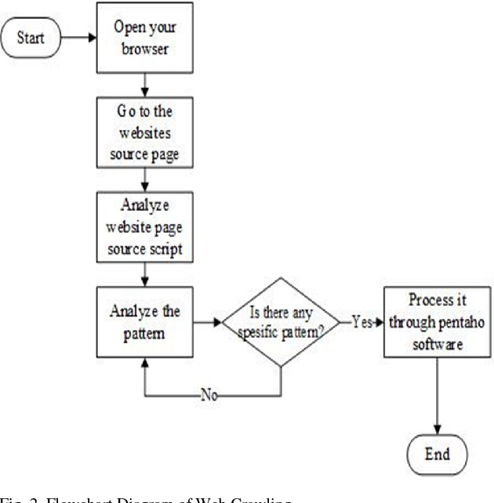
Data flow diagram

Slide 6
APPLICATIONS
Monitoring e-commerce prices
Finding opportunities for investment
Analyzing social media web data
Gathering web data automatically
Researching new concepts in a field
Monitoring news sources

Slide 7
MODULES USED
BEAUTIFUL SOUP LIBRARY: Beautiful Soup is a Python library for pulling data out of HTML and XML files. It is commonly used for scraping websites and simply getting data out of a known HTML/XML structure.
REQUEST LIBRARY:Requests library is one of the integral part of Python for making HTTP requests to a specified URL. Whether it be REST APIs or Web Scraping, requests is must to be learned for proceeding further with these technologies. When one makes a request to a URI, it returns a response. Python requests provides inbuilt functionalities for managing both the request and response.

Slide 8
MODEL FOR WEB SCRAPPING

Slide 9
CONCLUSION

Slide 10
THANK YOU!

